Slide 1
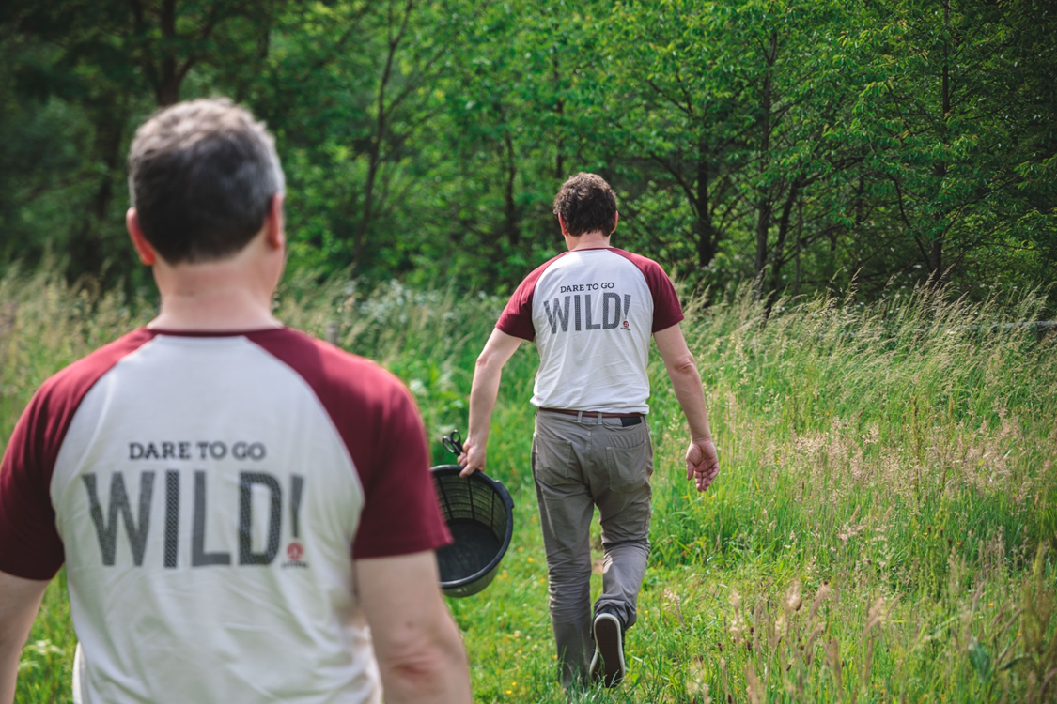
Brewery
ALVINNE

Slide 2
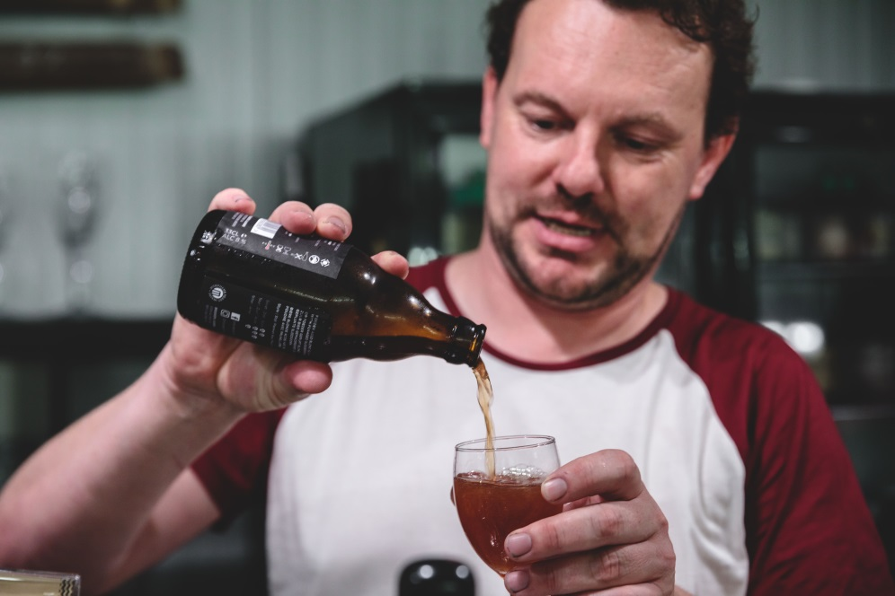
Contents
Why drink Alvinne?
The Brewery
The Team
Morpheus Yeast
Fruit
Wood
Flemish Sour Ales
Beers

Slide 3
Why drink Alvinne?
1
World-class
Alvinne produces world-class sour beers. Consistency is key, which allows us to serve our beer in top bars worldwide.
2
Authenticity
Morpheus yeast is a strong contributor to the flavour of our beer and gives us our own identity. Call it the Alvinne touch!
All our sour beers are brewed with our own unique yeast, harvested from a natural environment.
3
Pure and Unique
Our sour fruit beers contain only real fruit, no syrups or concentrates. Some of our beers contain rare and unusual berries, which you’ve probably never tasted in a beer before. That’s why we can only offer our seasonal fruit beers in limited quantities.
4
Time
In a world where everything is fast paced and instant, we prefer to give our beers time to mature and develop their wonderful aromas. Our old foeders and carefully selected wine barrels play a big part in this.
5
Warm-heartedness
We love to engage with you. We participate in lots of festivals and events because we love to meet you and have a chat about our beers. You are invited to join us in our taproom (Proefloft) at the brewery.
We love giving you a good time!
The Alvinne Team

Slide 4
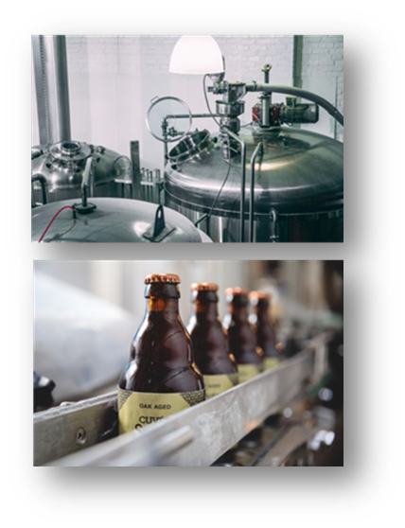
The Brewery
The brewery was established in 2004 and is located in Moen, Belgium.
Production volume is about 1000hl per year, of which more then half is for export.
We produce more than 30 different beers.
We have 10 conditioning tanks for young beers and fruit beers, 5 foeders and 100 wine barrels.
We also own our own bottling line.

Slide 5
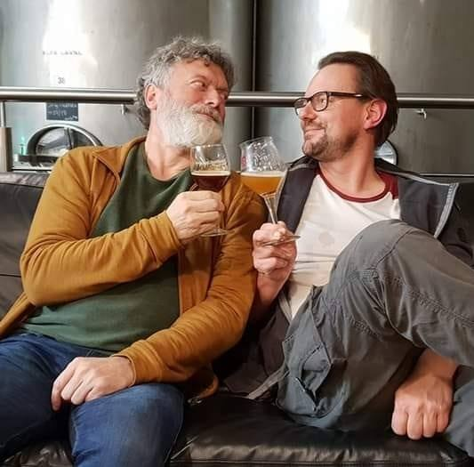
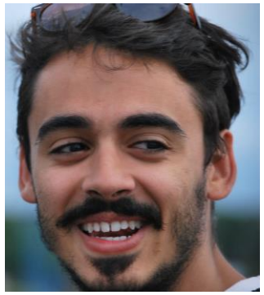
The Team
Our goal: to provide you with good moments!
Glenn Castelein
Managing Director
Marc De Keukeleire
Yeast management, special projects
Ricardo Murgioni
Brewer

Slide 6
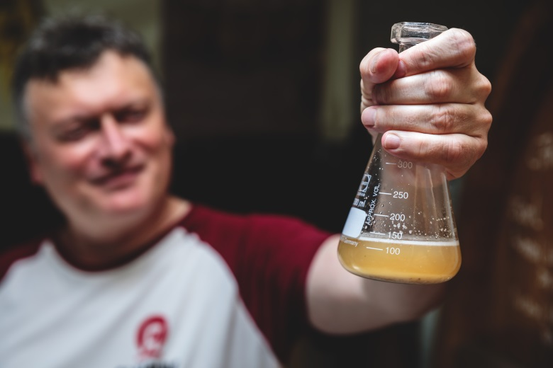
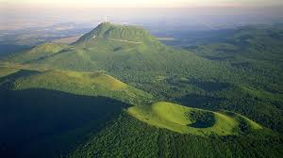
Morpheus Yeast
Our brewery is strongly dependent on Morpheus yeast, our house yeast strain, which enables us to brew sour and non-sour beers. In 2008, our yeast whisperer Marc picked a wild yeast culture in the French Auvergne and patiently selected, isolated and cultivated the now famous Morpheus yeast to the desired standard.
The yeast is named Morpheus yeast and has become world famous.
Morpheus is a mixed culture of 2 yeast strains (saccharomyces cerevisae) and lactobacillus. For brewing Traditional Ales, the lactobacillus can be deactivated.
Morpheus yeast gives our beers the recognizable Alvinne touch. According to yeast whisperer Marc, you need 3 ingredients to nurture your house yeast; discipline, passion and love. Every single day!

Slide 7
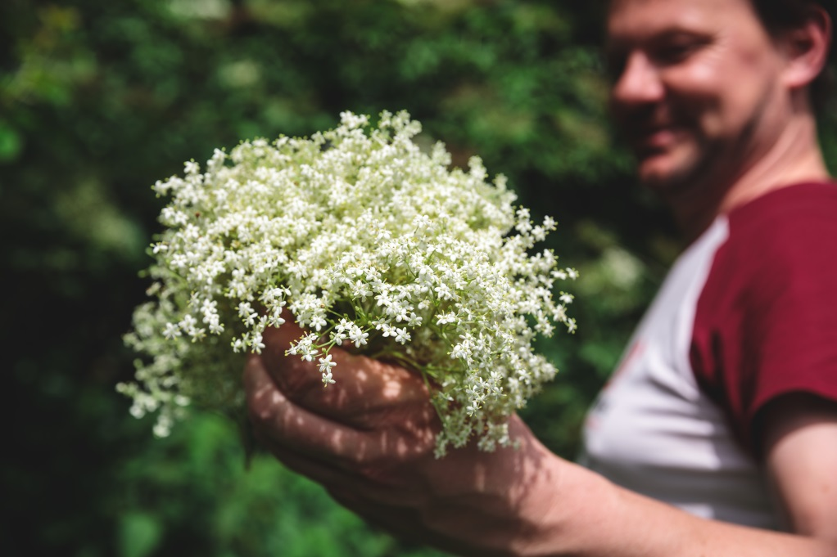
Fruit
Alvinne only uses whole fruit, no purees or concentrates, resulting in a slow maturation and giving the beer a delicate complexity.
We love being creative - Traditionally cherries and raspberries are used for beer, but we love to experiment with more unusual fruits such as quince and smoked pineapple.
Sloeberries are handpicked every year by Glenn and his team of volunteers. Occasionally we source unusual berries from Scandinavia. peppers from the Basque Country and eucalyptus from Portugal.
From time to time, we also experiment with special botanicals such as peppers from the Basque Country or Eucalyptus from Portugal

Slide 8
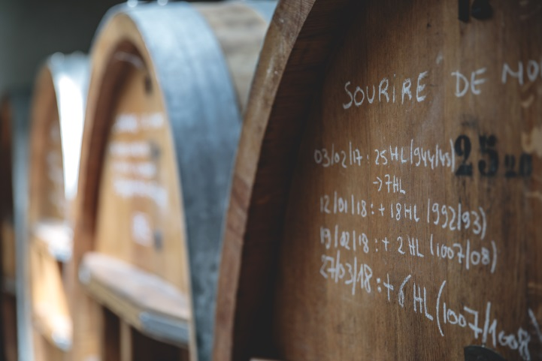
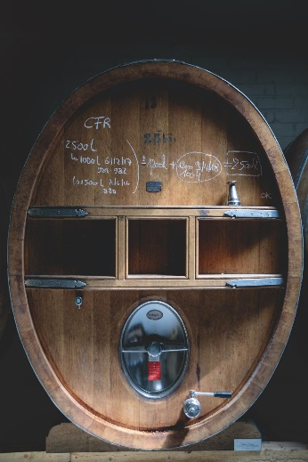
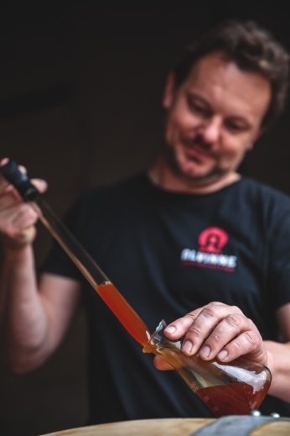
Wood
We consider the wood the barrel is made from to be an active ingredient in our beer. It releases a range of complex flavours created by the liquid the barrel previously contained (usually wine) and slowly sours the beer. Alvinne is a pioneer of barrel aged beers in Europe, a tradition that used to be common practice ages ago.
Our beer is matured in a beautiful collection of unique wine barrels, some originating from Sauterne, Banyuls etc. We also use Sherry and Calvados barrels.
For our Flemish Sour Ales, we have a collection of 5 foeders. The foeder features in our logo.

Slide 9
Flemish Sour Ales
Flemish Sour Ale is a term we prefer to use rather than the official historical beer styles of “Flemish Old Brown” (Vlaams Oud Bruin) or “Flemish Red Brown” (Vlaams Rood Bruin), because we believe these terms don’t cover what our range of sour beers have to offer.
Alvinne has revitalized and truly innovated these Flemish beer styles. We use age-old mixed fermentation techniques and offer beers that have matured in stainless steel tanks, wine barrels and foeders.
Our beers range from pale to dark, from 4 to 8% ABV, with or without fruit and sour or not too sour. Historically, beers have always been slightly sour, and we just love it:
DARE TO GO WILD!

Slide 10
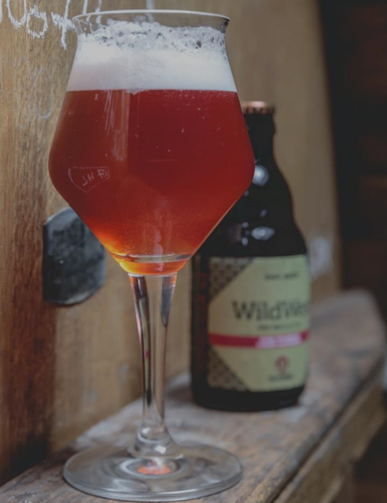
Beers
Flemish Sour Ales
Try our exciting and innovative take on age-old sour beer styles. We have developed 4 delicious recipes, each of which are available as a standard beer or in a barrel-aged version. Barrel aged versions are available with or without fruit. Be amazed by their delicate and refreshing flavour!
1. Berliner Ryesse (Standard or Fruit) ……………………..….pale 4%
2. Omega (Standard or Fruit), Wild West* ………….…..…..pale 6%
3. Phi (Standard or Fruit), Cuvée Sofie* …………………...….pale 8%
4. Sigma (Standard or Fruit), Cuvée Freddy* ……..……..….dark 8%
*barrel aged

Slide 11
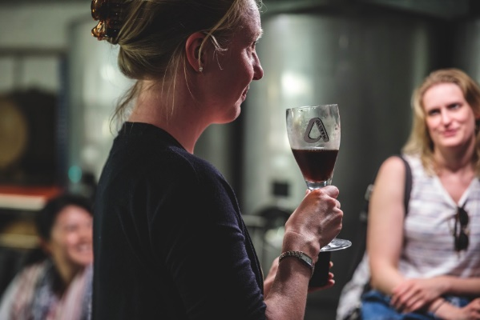
Beers
Traditional Ales
On top of our sour beer range, we also produce also a complete range of 4 traditional beers. A light pale ale such as a Morpheus Saison, a smooth rye Tripel, and 2 full bodied Barley Wines.
1. Morpheus Saison…………………………………………...……….pale 6%
2. MoenRye Tripel……………………………………………..………..pale 9%
3. Cuvée d'Erpigny*……………….…………………………………...pale 12%
4. Land van Mortagne, Cuvée De Mortagne* …………….dark 13%
*barrel aged

Slide 12
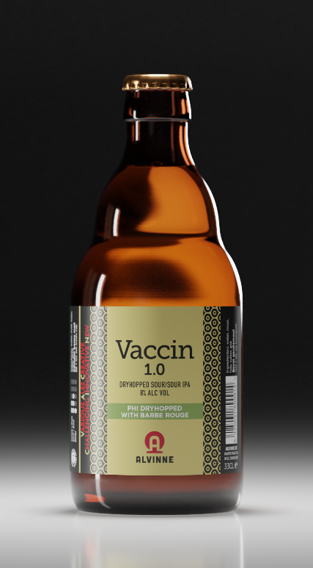
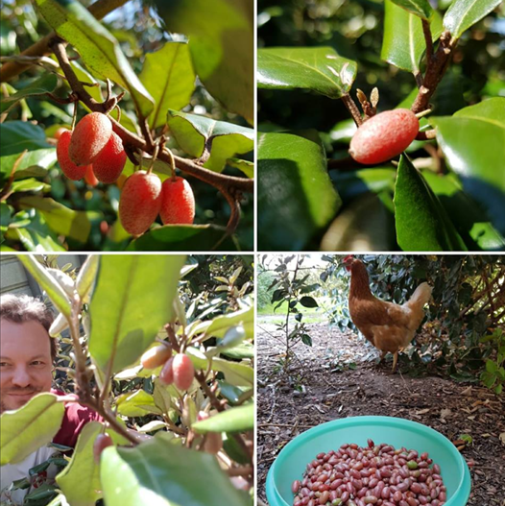
Beers
Occasional Beers
Occasional beers such as collaborations, the Vaccin beers or small scale experimental brews earmarked for Alvinne’s Fellowship of Exceptional Ales contribute to the innovation and even enhancement of our current range.
The Fellowship’s purpose is to allow our loyal fans to be first in line to receive our most limited editions (maximum 400 liter).

Slide 13
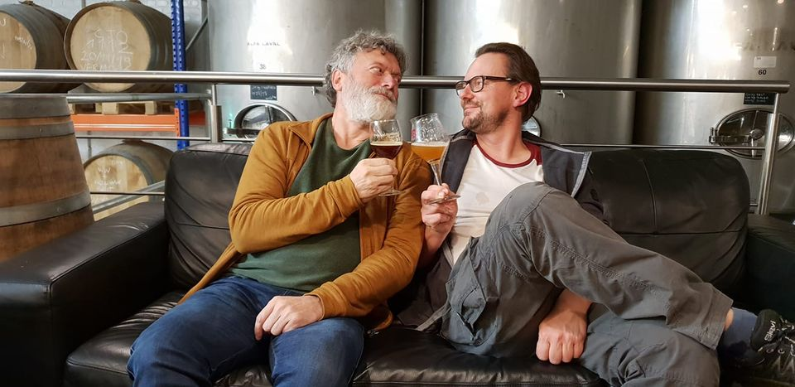
CHEERS!

